Slide 1
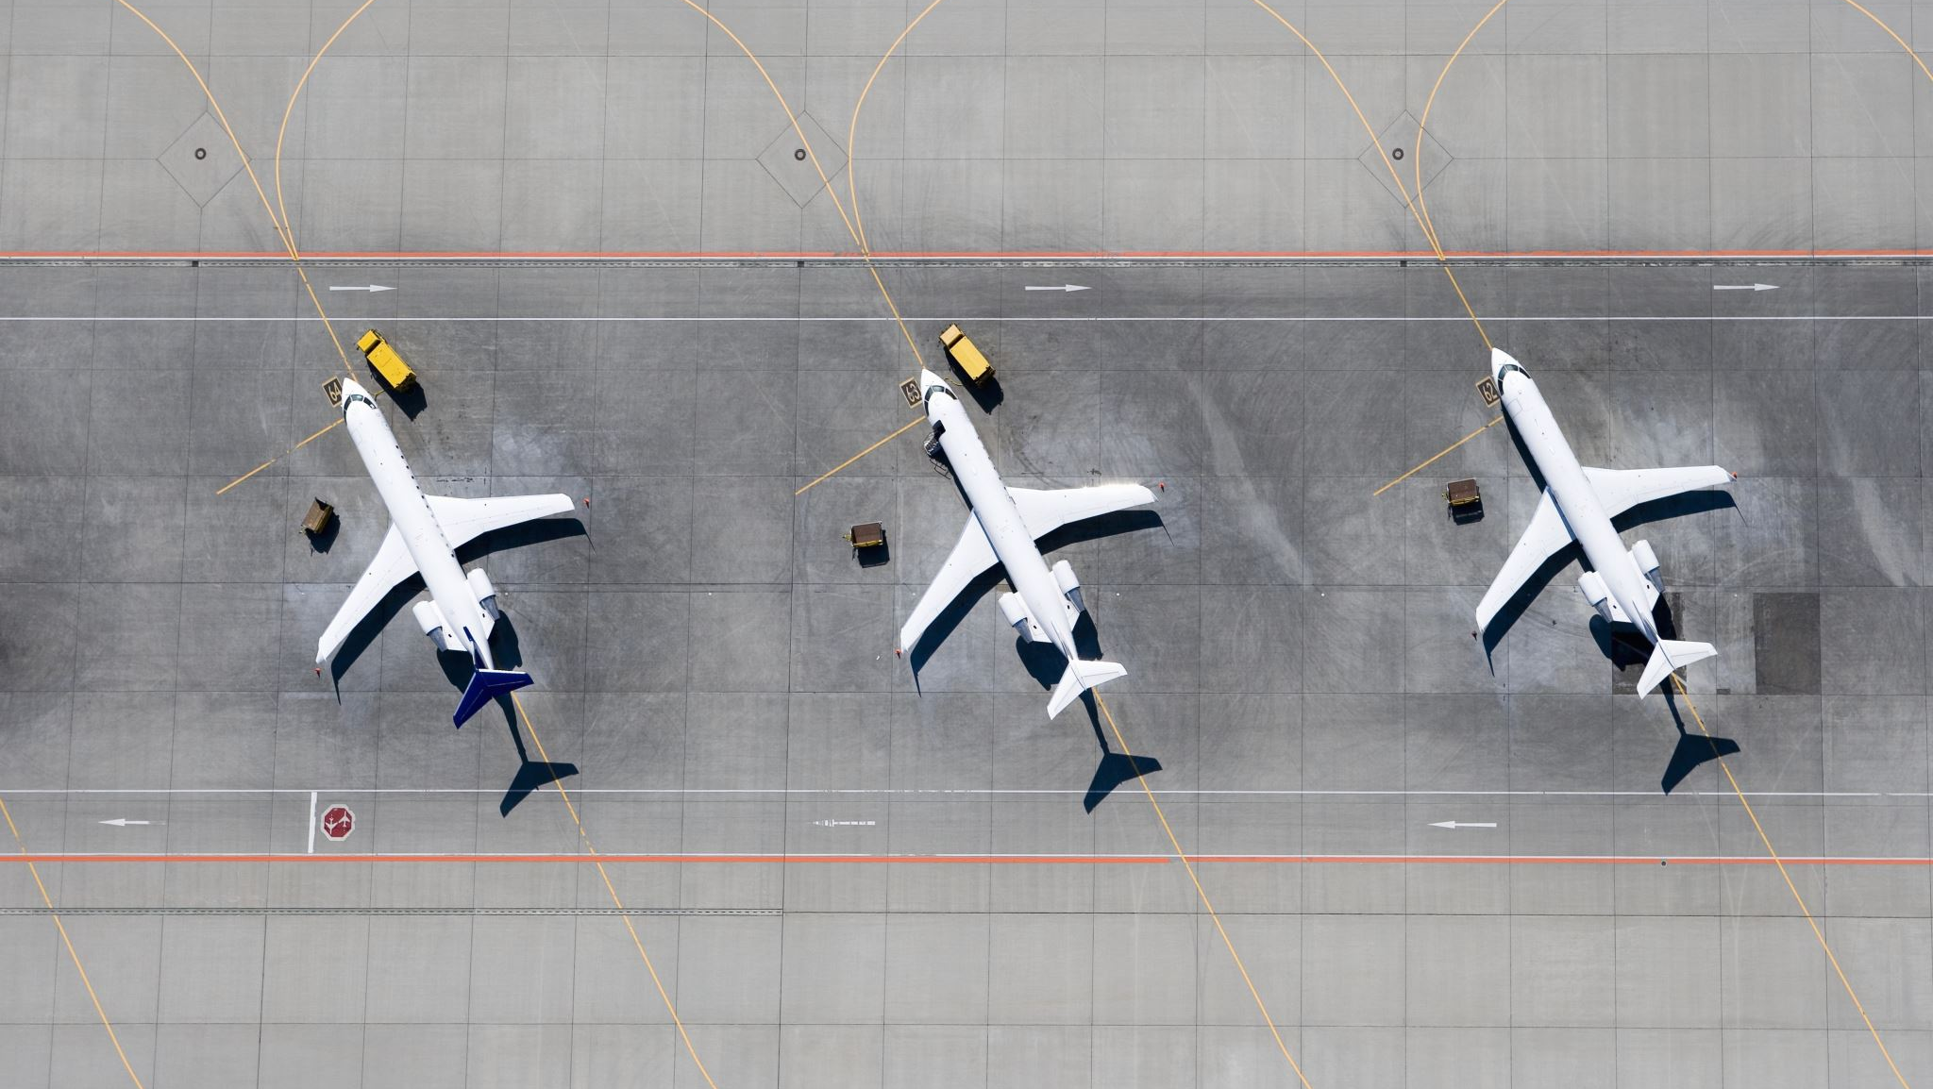
Air Traffic Control & VISUALIZATIONN
CIS 663 Developing Analytical Applications

Slide 2

Flow Over an “ATC”
What is an ATC
Terms
Literature
Research Question
Packages and DATA
Methodology
Model
Results

Slide 8

Thanks

